Slide 1
Introduction to Database Systems

Slide 2
Definition
Databases are systems that allow users to store and organize data.
Database systems are used to manage collections of data that are:
Highly valuable
Relatively large
Accessed by multiple users and applications, often at the same time.

Slide 3
Definition
Database Management System (DBMS) contains information about an enterprise
Collection of interrelated data
Set of programs to access the data
An environment that is both convenient and efficient to use
A modern database system is a complex software system whose task is to manage a large, complex collection of data.
Databases touch all aspects of our lives

Slide 4
Applications
Banking: transactions, customer information
Airlines: reservations, schedules
Universities: registration, grades
Sales: customers, products, purchases
Manufacturing: production, inventory, orders, supply chain
Human resources: employee records, salaries, tax deductions
Telecommunication: records of calls, texts, and data usage

Slide 5
Drawbacks of using file systems
Data redundancy and inconsistency
Multiple file formats, duplication of information in different files
Difficulty in accessing data
Need to write a new program to carry out each new task
Data isolation
Multiple files and formats
Integrity problems
Integrity constraints (e.g., account balance > 0) become “buried” in program code rather than being stated explicitly
Hard to add new constraints or change existing ones

Slide 6
Drawbacks of using file systems (Cont.)
Atomicity of updates
Example: Transfer of funds from one account to another should either complete or not happen at all
Concurrent access by multiple users
Uncontrolled concurrent accesses can lead to inconsistencies
Example: Two people reading a balance (say 100) and updating it by withdrawing money (say 50 each) at the same time
Security problems
Hard to provide user access to some, but not all, data
Database systems offer solutions to all the above problems

Slide 7
University Database Example
Data consists of information about:
Students
Instructors
Classes
Application program examples:
Add new students, instructors, and courses
Register students for courses, and generate class rosters
Assign grades to students, compute grade point averages (GPA) and generate transcripts

Slide 8
Spreadsheets vs Database
Spreadsheets
Database
One-time analysis
Quickly need to chart something out
Reasonable data set size
Ability for untrained people to work with data
Data integrity
Can handle massive amounts of data
Automate steps for re-use
Can support data for websites and applications

Slide 9
Levels of Abstraction
Physical level: describes how a record (e.g., instructor) is stored.
Logical level: describes data stored in database, and the relationships among the data.
type instructor = record
ID : string; name : string; dept_name : string; salary : integer;
end;
View level: application programs hide details of data types.
Views can also hide information (such as an employee’s salary) for security purposes.

Slide 10
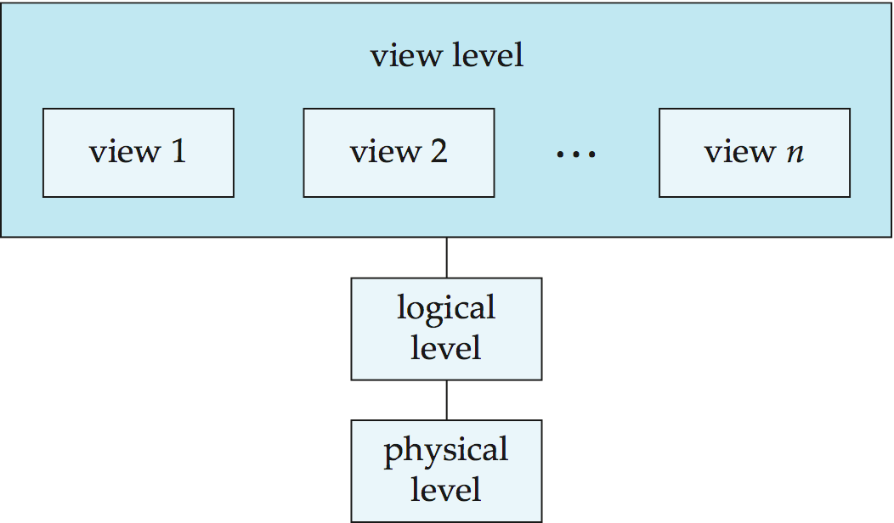
View of Data
An architecture for a database system

Slide 11
Instances and Schemas
Instance – the actual content of the database at a particular point in time
Schema - The overall design of the database
Logical Schema – the overall logical structure of the database
Example: The database consists of information about a set of customers and accounts in a bank and the relationship between them
Physical schema– the overall physical structure of the database
Subschemas - different schemas at the view level for different views of the database.
Physical Data Independence – the ability to modify the physical schema without changing the logical schema

Slide 12
Data Models
A collection of tools for describing
Data
Data relationships
Data semantics
Data constraints
Relational model
Entity-Relationship data model
Object-Based Data Model
Semi-structured data model (XML)

Slide 13
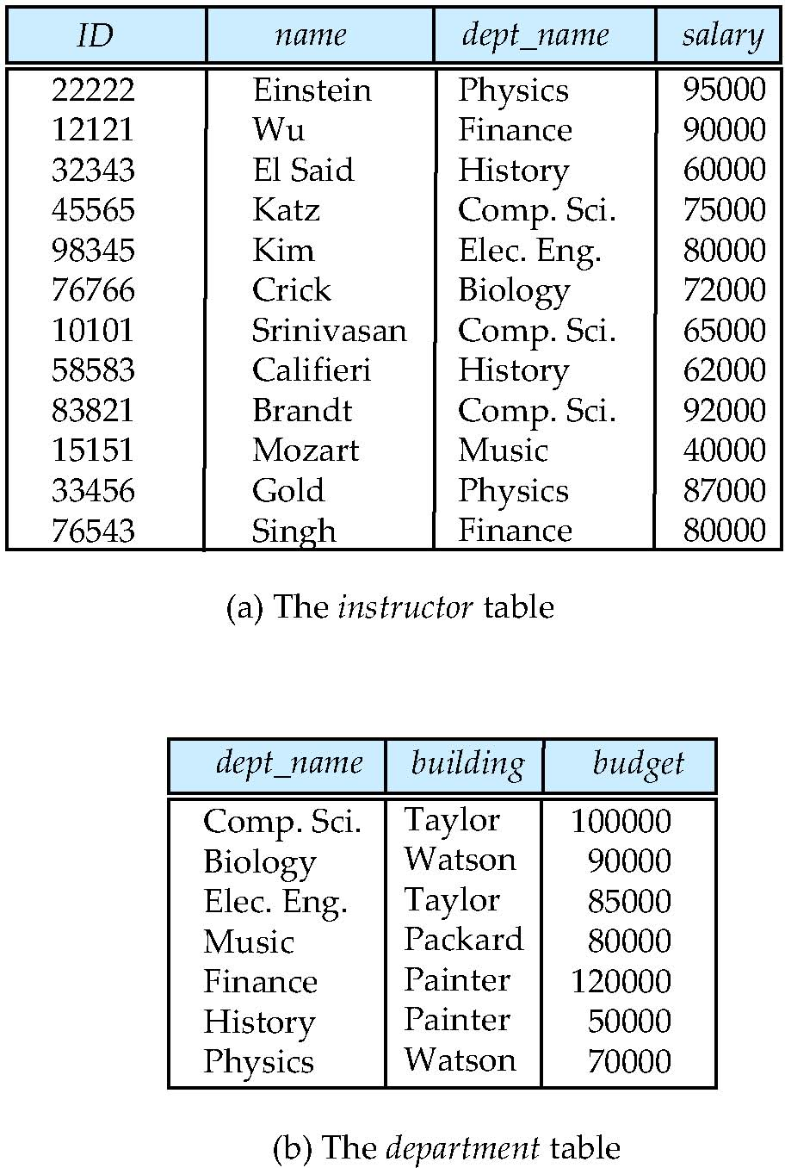
Relational Model
All the data is stored in various tables.
Example
Columns
Rows

Slide 14
A Sample Relational Database
The department table
The instructor table

Slide 15
Data Definition Language (DDL)
Specification notation for defining the database schema Example: create table instructor ( ID char(5), name varchar(20), dept_name varchar(20), salary numeric(8,2))
DDL compiler generates a set of table templates stored in a data dictionary
Data dictionary contains metadata (i.e., data about data)
Database schema
Integrity constraints
Primary key
Authorization
Who can access what

Slide 16
Data Manipulation Language (DML)
Language for accessing and manipulating the data organized by the appropriate data model
DML also known as query language
Two types of languages
Procedural DMLs require a user to specify what data are needed and how to get those data.
Declarative DMLs require a user to specify what data are needed without specifying how to get those data.

Slide 17
Data Manipulation Language (DML)
Two classes of languages
Pure – used for proving properties about computational power and for optimization
Relational Algebra
Tuple relational calculus
Domain relational calculus
Commercial – used in commercial systems
SQL is the most widely used commercial language

Slide 18
SQL
The most widely used commercial language
To be able to compute complex functions SQL is usually embedded in some higher-level language
SQL does not support actions such as input from users, output to displays, or communication over the network.
Application programs generally access databases through one of
Language extensions to allow embedded SQL
Application program interface (e.g., ODBC/JDBC) which allow SQL queries to be sent to a database

Slide 19
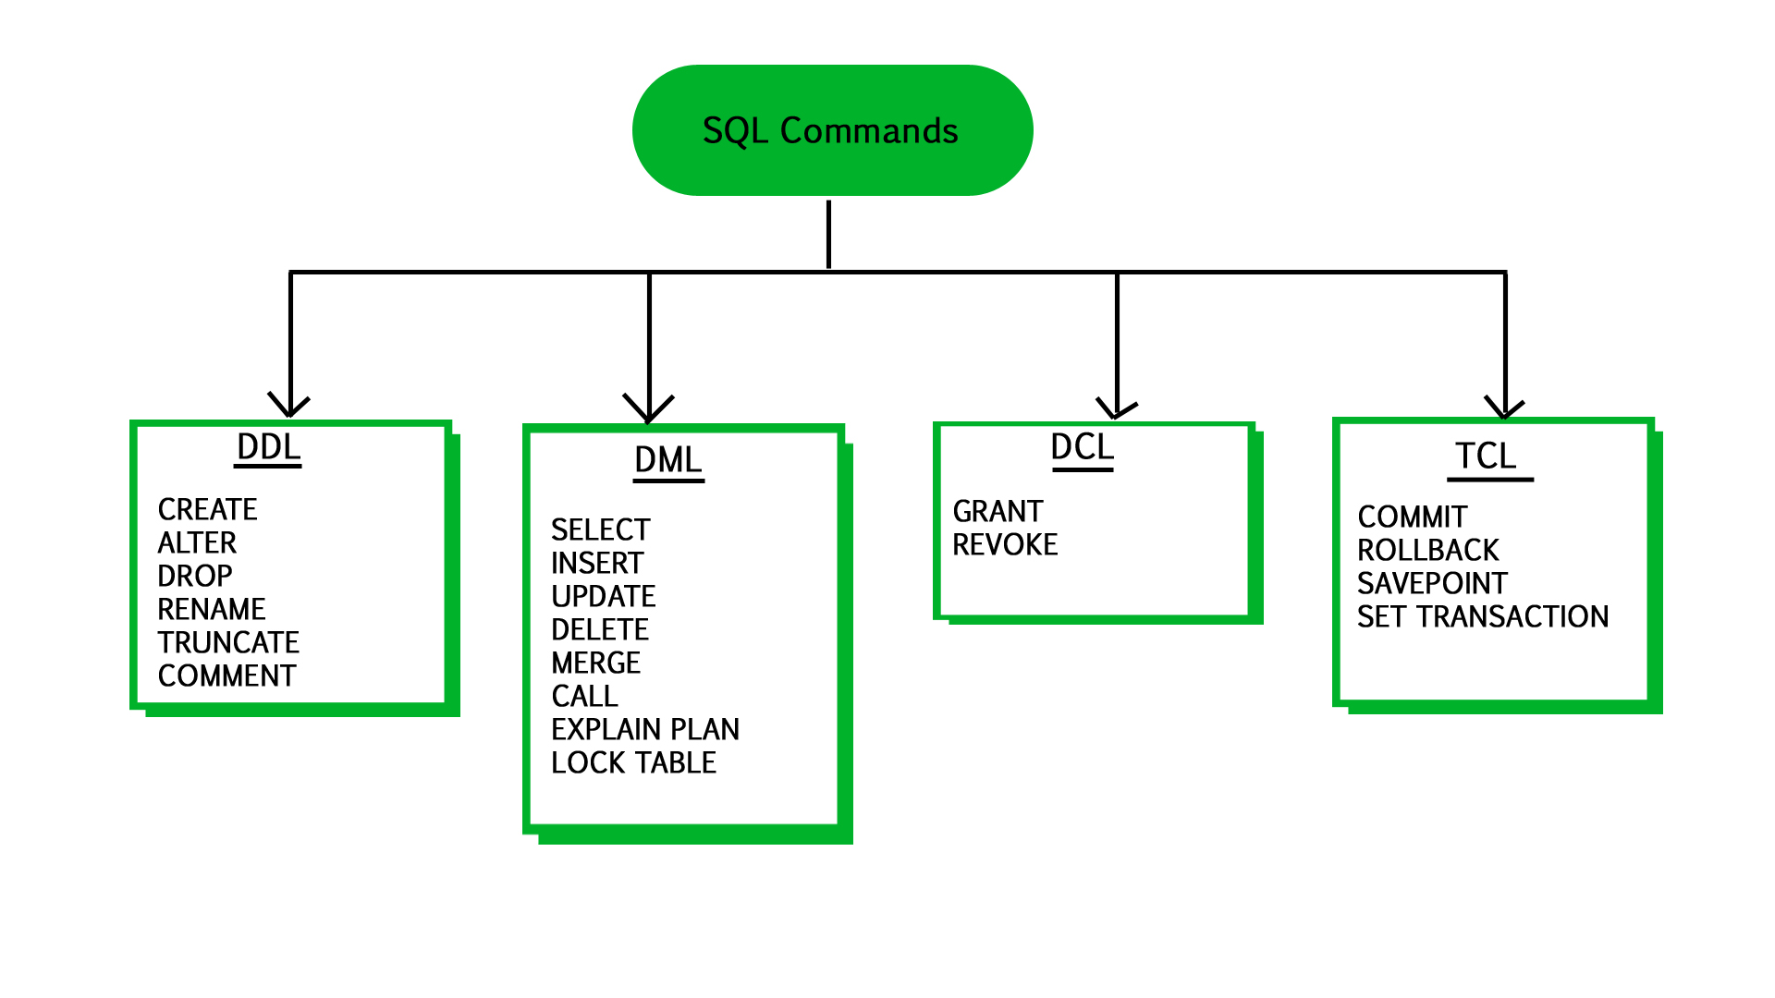
SQL
Data Control Language
Data Definition Language
Transaction Control Language
Data Manipulation Language

Slide 20
Database Design
Logical Design – Deciding on the database schema. Database design requires that we find a “good” collection of relation schemas.
Business decision – What attributes should we record in the database?
Computer Science decision – What relation schemas should we have and how should the attributes be distributed among the various relation schemas?
Physical Design – Deciding on the physical layout of the database.

Slide 21
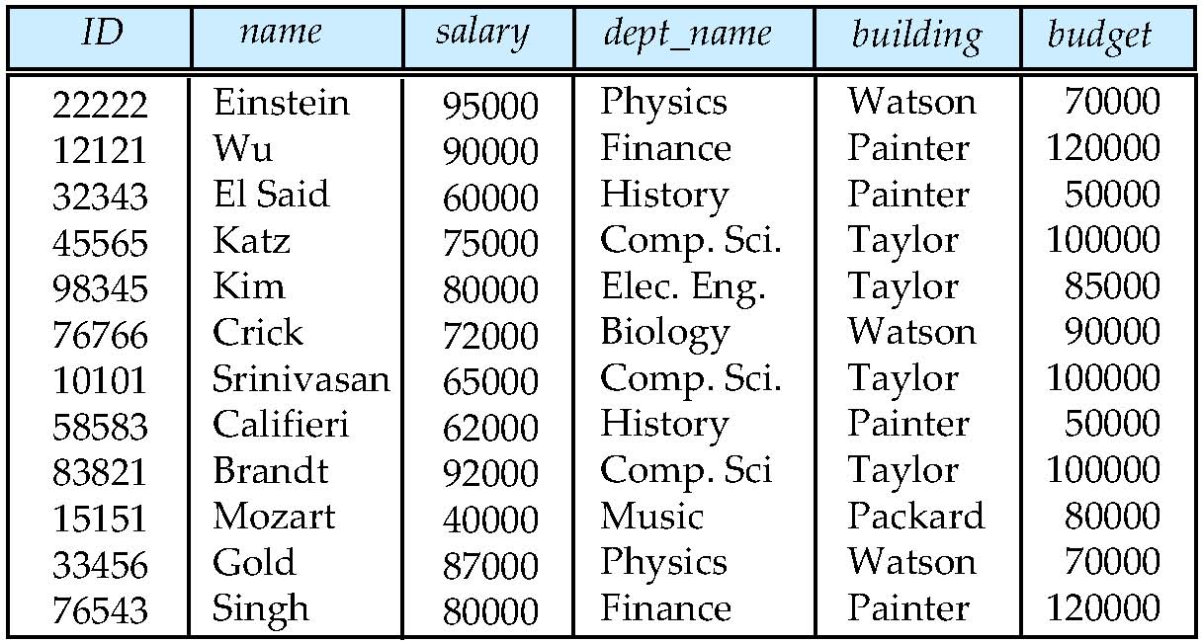
Database Design (Cont.)
Is there any problem with this relation?

Slide 22
Design Approaches
Need to come up with a methodology to ensure that each of the relations in the database is “good”
Two ways of doing so:
Entity Relationship Model
Models an enterprise as a collection of entities and relationships
Represented diagrammatically by an entity-relationship diagram
Normalization Theory
Formalize what designs are bad, and test for them

Slide 23
Database Engine
A database system is partitioned into modules that deal with each of the responsibilities of the overall system.
The functional components of a database system can be divided into
Storage manager
Query processing
Transaction manager

Slide 24
Storage Management
Storage manager is a program module that provides the interface between the low-level data stored in the database and the application programs and queries submitted to the system.
The storage manager is responsible to the following tasks:
Interaction with the OS file manager
Efficient storing, retrieving and updating of data
Issues:
Storage access
File organization
Indexing and hashing

Slide 25
Query Processing
The query processor components include:
DDL interpreter -- interprets DDL statements and records the definitions in the data dictionary.
DML compiler -- translates DML statements in a query language into an evaluation plan consisting of low-level instructions that the query evaluation engine understands.
The DML compiler performs query optimization; that is, it picks the lowest cost evaluation plan from among the various alternatives.
Query evaluation engine -- executes low-level instructions generated by the DML compiler.

Slide 26
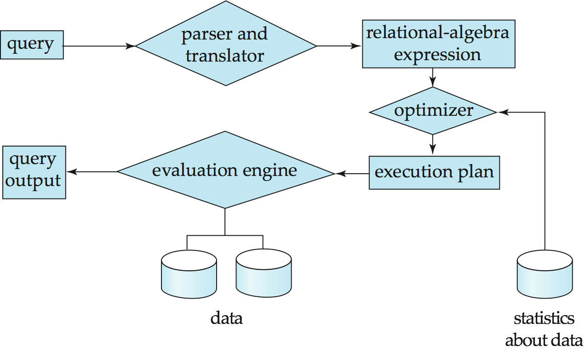
Query Processing
1. Parsing and translation
2. Optimization
3. Evaluation

Slide 27
Transaction Management
What if the system fails?
What if more than one user is concurrently updating the same data?
A transaction is a collection of operations that performs a single logical function in a database application
Transaction-management component ensures that the database remains in a consistent (correct) state despite system failures (e.g., power failures and operating system crashes) and transaction failures.
Concurrency-control manager controls the interaction among the concurrent transactions, to ensure the consistency of the database.

Slide 28
Database Users
Naive users: unsophisticated users who interact with the system by invoking one of the application programs that have been written previously.
Application programmers: are computer professionals who write application programs.
Sophisticated users: interact with the system without writing programs
using a database query language or by
using tools such as data analysis software.
Specialized users: write specialized database applications that do not fit into the traditional data-processing framework. For example, CAD, graphic data, audio, video.

Slide 29
Database Administrator
A person who has central control over the system is called a database administrator (DBA), whose functions are:
Schema definition
Storage structure and access-method definition
Schema and physical-organization modification
Granting of authorization for data access
Routine maintenance
Periodically backing up the database
Ensuring that enough free disk space is available for normal operations, and upgrading disk space as required
Monitoring jobs running on the database and ensuring that performance is not degraded by very expensive tasks submitted by some users

Slide 30
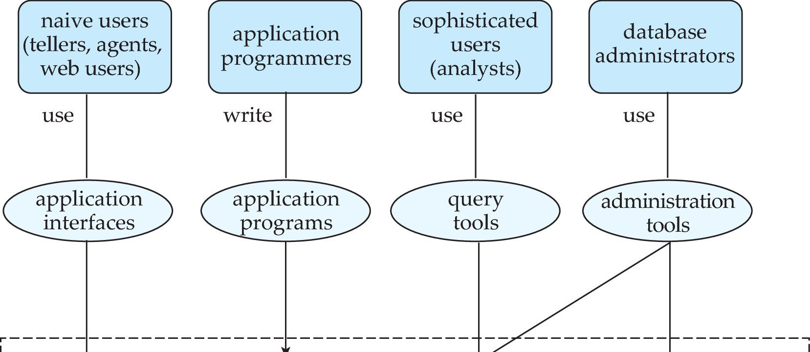
Database Users and Administrators
Database

Slide 31
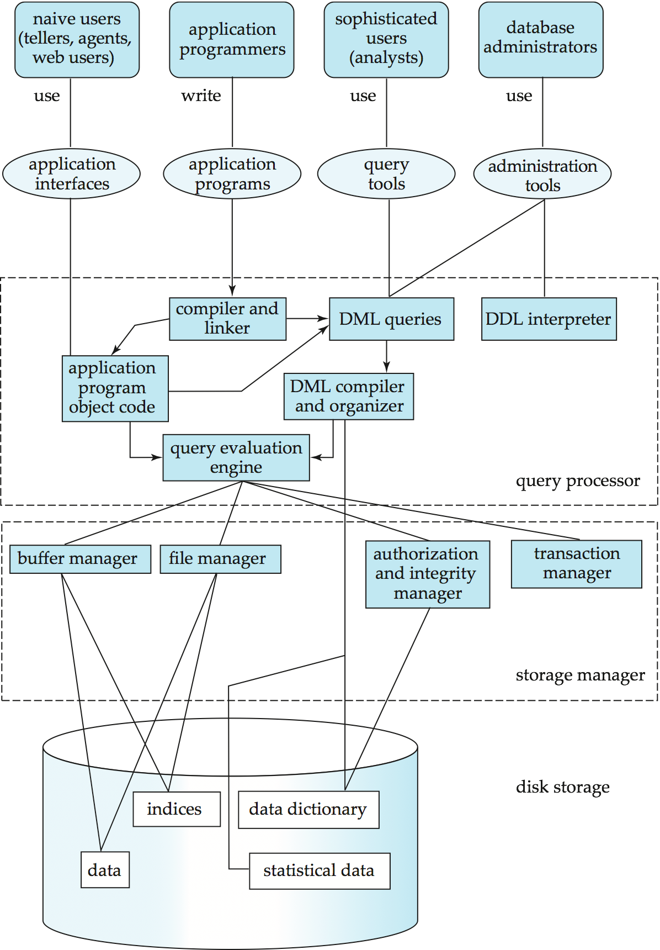
Database System Internals

Slide 32
Database Architecture
The architecture of a database systems is greatly influenced by
the underlying computer system on which the database is running:
Centralized
Client-server
Parallel (multi-processor)
Distributed

Slide 33
Database Applications
Two-tier architecture: the application resides at the client machine, where it invokes database system functionality at the server machine
Three-tier architecture: the client machine acts as a front end and does not contain any direct database calls.
The client end communicates with an application server, usually through a forms interface.
The application server in turn communicates with a database system to access data.

Slide 34
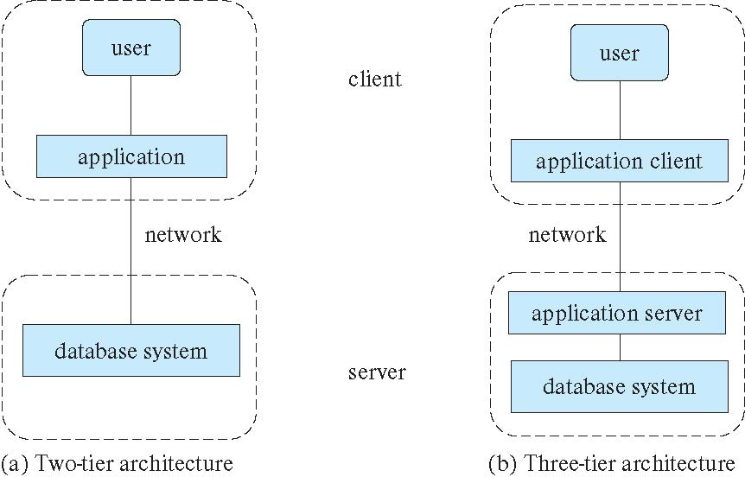
Database Applications

